Slide 1
Data Structures and Algorithms Design
Febin.A.Vahab
2019-20

Slide 2
Qn1:Traversal
    If the inorder traversal of a binary tree prints nodes labelled C D E N P X Y and the post order traversal of binary tree prints nodes labelled D C E P Y X N, then what sequences of labels does the pre order traversal print?
Page <number>

Slide 3
Qn1:Traversal-ANSWER-HINT
    Inorder traversal -C D E N P X Y
    Post order traversal - D C E P Y X N
    We first find the last node in postorder. The last node is “N”, we know this value is root as root always appear in the end of postorder traversal.
    We search “N” in inorder to find left and right subtrees of root. Everything on left of “N” in inorder is in left subtree and everything on right is in right subtree.
Page <number>

Slide 4
Qn2:INSERTION & SEARCH
Prof X is standing at the door of his classroom. There are currently N students in the class, i th student got A_{i} candies. There are still M more students to come. At every instant, a student enters the class and wishes to be seated with a student who has exactly the same number of candies. For each student, Professor shouts YES if such a student is found, NO otherwise. Even if the student entering the class can't find a partner with equal no. of candies, he will still enter the class and be seated.
Identify a data structure to implement the above problem statement.
Page <number>

Slide 5
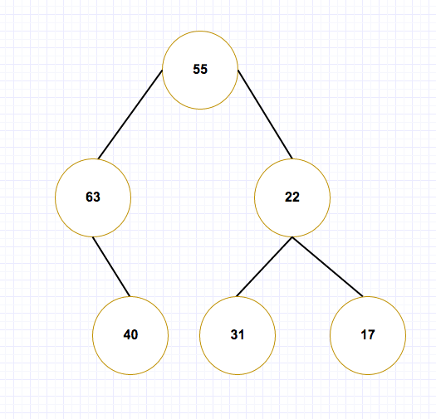
Qn3:
Suppose the keys 55,63,31,17,22,40 are inserted into a binary tree in that order. Which of the following is the BST that is formed?
Page <number>

Slide 6
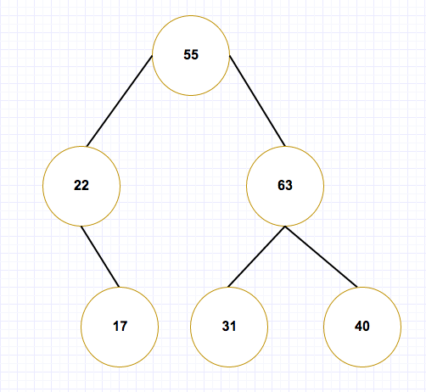
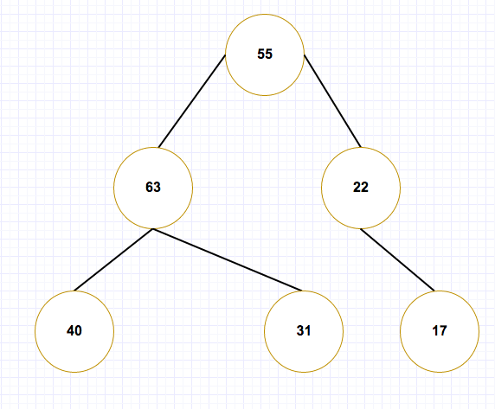
Qn3 :
Page <number>

Slide 7
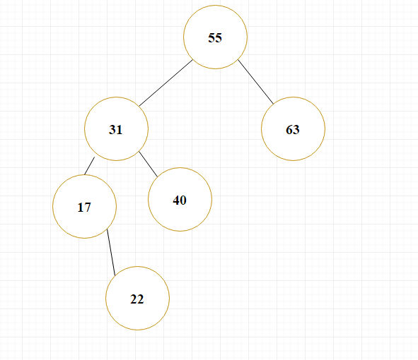
Qn3 :
Page <number>

Slide 8
Qn4:LCA
Given a binary search tree and two values say n1 and n2, write a program to find the least common ancestor. You may assume that both the values exist in the tree.
Page <number>

Slide 9
Qn5:Sucessor and Predecessor
In a Binary Search Tree, the successor of a given key is the smallest number which is larger than the key. In the same way, a predecessor is the largest number which is smallest than the key. Write an algorithm (with pseudocode) to find the successor and predecessors of a given key.
Page <number>

